Slide 1
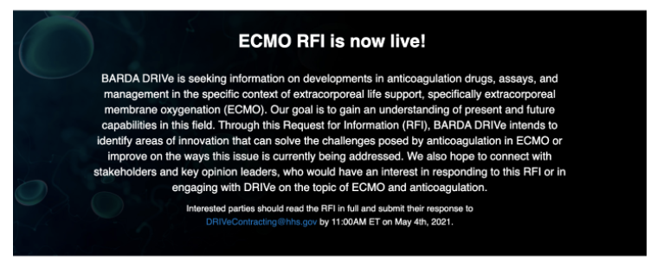
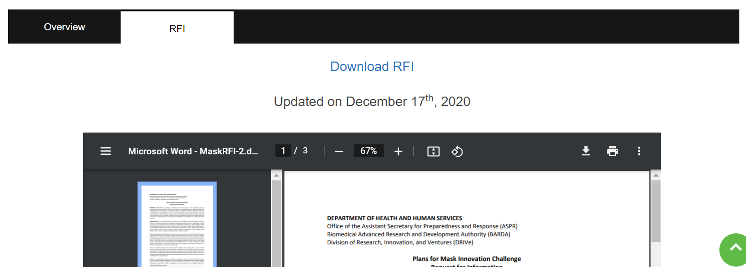
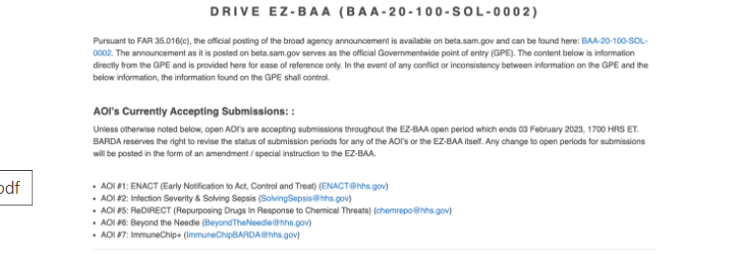
Not needed at this stage, since ECMO is not a program yet?
Add some kind of separation from the EZ BAA information below ?
Added space, or line, or use of color/shape?
Or a way to indicate a clear transition back to EZ BAA information?

